Slide 1
Position of a Parser in the Compiler Model
Token, tokenval
Source Program
Lexical Analyzer
Parser and rest of front-end
Intermediate representation
Get next token
Lexical error
Syntax error Semantic error
Symbol Table

Slide 2
The Parser
A parser implements a C-F grammar as a recognizer of strings
The role of the parser in a compiler is twofold:
To check syntax (= string recognizer)
And to report syntax errors accurately
To invoke semantic actions
For static semantics checking, e.g. type checking of expressions, functions, etc.
For syntax-directed translation of the source code to an intermediate representation

Slide 3
Syntax-Directed Translation
One of the major roles of the parser is to produce an intermediate representation (IR) of the source program using syntax-directed translation methods
Possible IR output:
Abstract syntax trees (ASTs)
Control-flow graphs (CFGs) with triples, three-address code, or register transfer list notation
WHIRL (SGI Pro64 compiler) has 5 IR levels!

Slide 5
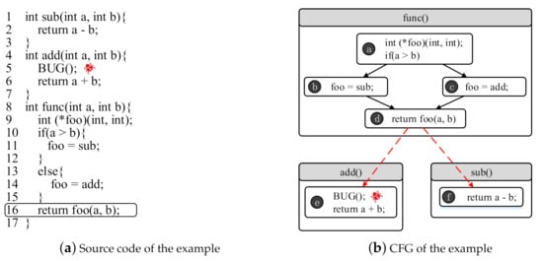

Slide 6
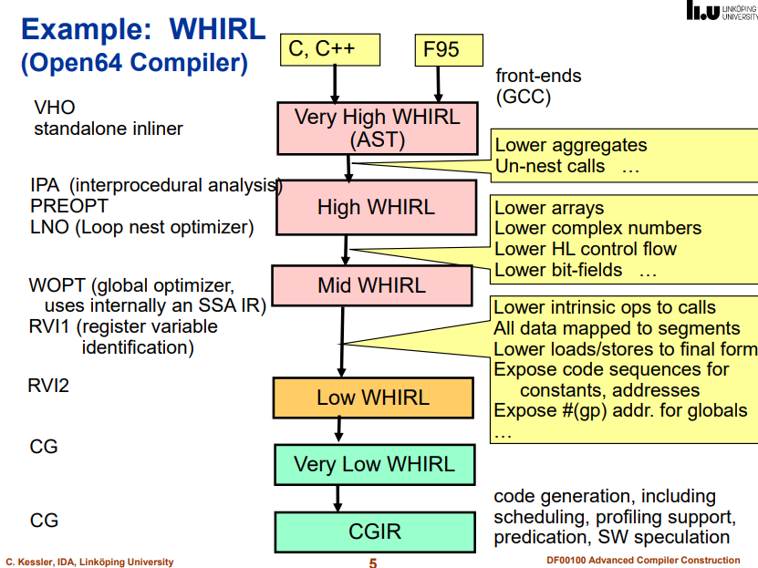

Slide 7
Error Handling
A good compiler should assist in identifying and locating errors
Lexical errors: important, compiler can easily recover and continue
Syntax errors: most important for compiler, can almost always recover
Static semantic errors: important, can sometimes recover
Dynamic semantic errors: hard or impossible to detect at compile time, runtime checks are required
Logical errors: hard or impossible to detect

Slide 8


Slide 9
Viable-Prefix Property
The viable-prefix property of parsers allows early detection of syntax errors
Goal: detection of an error as soon as possible without further consuming unnecessary input
How: detect an error as soon as the prefix of the input does not match a prefix of any string in the language
Error is detected here
Error is detected here
… for (;) …
… DO 10 I = 1;0 …
Prefix
Prefix

Slide 10
Error Recovery Strategies
Panic mode
Discard input until a token in a set of designated synchronizing tokens is found
Phrase-level recovery
Perform local correction on the input to repair the error
Error productions
Augment grammar with productions for erroneous constructs
Global correction
Choose a minimal sequence of changes to obtain a global least-cost correction

Slide 11
Grammars (Recap)
Context-free grammar is a 4-tuple G = (N, T, P, S) where
T is a finite set of tokens (terminal symbols)
N is a finite set of nonterminals
P is a finite set of productions of the form α → β where α ∈ (N∪T)* N (N∪T)* and β ∈ (N∪T)*
S ∈ N is a designated start symbol

Slide 12
Notational Conventions Used
Terminals a,b,c,… ∈ T specific terminals: 0, 1, id, +
Nonterminals A,B,C,… ∈ N specific nonterminals: expr, term, stmt
Grammar symbols X,Y,Z ∈ (N∪T)
Strings of terminals u,v,w,x,y,z ∈ T*
Strings of grammar symbols α,β,γ ∈ (N∪T)*

Slide 13
Derivations (Recap)
The one-step derivation is defined by α A β ⇒ α γ β where A → γ is a production in the grammar
In addition, we define
⇒ is leftmost ⇒_{lm} if α does not contain a nonterminal
⇒ is rightmost ⇒_{rm} if β does not contain a nonterminal
Transitive closure ⇒* (zero or more steps)
Positive closure ⇒⁺ (one or more steps)
The language generated by G is defined by L(G) = {w ∈ T* | S ⇒⁺ w}

Slide 14
Derivation (Example)
Grammar G = ({E}, {+,*,(,),-,id}, P, E) with productions P = E → E + E E → E * E E → ( E ) E → - E E → id
Example derivations:
E ⇒ - E ⇒ - id
E ⇒_{rm} E + E ⇒_{rm} E + id ⇒_{rm} id + id
E ⇒* E
E ⇒* id + id
E ⇒⁺ id * id + id

Slide 15
Chomsky Hierarchy: Language Classification
A grammar G is said to be
Regular if it is right linear where each production is of the form A → w B or A → w or left linear where each production is of the form A → B w or A → w
Context free if each production is of the form A → α where A ∈ N and α ∈ (N∪T)*
Context sensitive if each production is of the form α A β → α γ β where A ∈ N, α,γ,β ∈ (N∪T)*, |γ| > 0
Unrestricted

Slide 16
Chomsky Hierarchy
L(regular) ⊂ L(context free) ⊂ L(context sensitive) ⊂ L(unrestricted)
Where L(T) = { L(G) | G is of type T } That is: the set of all languages generated by grammars G of type T
Examples:
Every finite language is regular! (construct a FSA for strings in L(G))
L₁ = { a^{n}b^{n} | n ≥ 1 } is context free
L₂ = { a^{n}b^{n}c^{n} | n ≥ 1 } is context sensitive

Slide 17
Parsing
Universal (any C-F grammar)
Cocke-Younger-Kasimi
Earley
Top-down (C-F grammar with restrictions)
Recursive descent (predictive parsing)
LL (Left-to-right, Leftmost derivation) methods
Bottom-up (C-F grammar with restrictions)
Operator precedence parsing
LR (Left-to-right, Rightmost derivation) methods
SLR, canonical LR, LALR

Slide 18
Top-Down Parsing
LL methods (Left-to-right, Leftmost derivation) and recursive-descent parsing
Grammar: E → T + T T → ( E ) T → - E T → id
Leftmost derivation: E ⇒_{lm} T + T ⇒_{lm} id + T ⇒_{lm} id + id
E
E
E
E
T
T
T
T
T
T
+
id
+
id
+
id

Slide 19
Left Recursion (Recap)
Productions of the form A → A α | β | γ are left recursive
When one of the productions in a grammar is left recursive then a predictive parser loops forever on certain inputs

Slide 20
A General Systematic Left Recursion Elimination Method
Input: Grammar G with no cycles or ε-productions
Arrange the nonterminals in some order A₁, A₂, …, A_{n} for i = 1, …, n do for j = 1, …, i-1 do replace each A_{i} → A_{j} γ with A_{i} → δ₁ γ | δ₂ γ | … | δ_{k} γ where A_{j} → δ₁ | δ₂ | … | δ_{k} enddo eliminate the immediate left recursion in A_{i} enddo

Slide 21
Immediate Left-Recursion Elimination
Rewrite every left-recursive production A → A α | β | γ | A δ into a right-recursive production: A → β A_{R} | γ A_{R} A_{R} → α A_{R} | δ A_{R} | ε

Slide 22
Example Left Recursion Elim.
A → B C | a B → C A | A b C → A B | C C | a
Choose arrangement: A, B, C
i = 1: nothing to do i = 2, j = 1: B → C A | A b ⇒ B → C A | B C b | a b ⇒_{(imm)} B → C A B_{R} | a b B_{R} B_{R} → C b B_{R} | ε i = 3, j = 1: C → A B | C C | a ⇒ C → B C B | a B | C C | a i = 3, j = 2: C → B C B | a B | C C | a ⇒ C → C A B_{R} C B | a b B_{R} C B | a B | C C | a ⇒_{(imm)} C → a b B_{R} C B C_{R} | a B C_{R} | a C_{R} C_{R} → A B_{R} C B C_{R} | C C_{R} | ε

Slide 23
Left Factoring
When a nonterminal has two or more productions whose right-hand sides start with the same grammar symbols, the grammar is not LL(1) and cannot be used for predictive parsing
Replace productions A → α β₁ | α β₂ | … | α β_{n} | γ with A → α A_{R} | γ A_{R} → β₁ | β₂ | … | β_{n}

Slide 24
Predictive Parsing
Eliminate left recursion from grammar
Left factor the grammar
Compute FIRST and FOLLOW
Two variants:
Recursive (recursive-descent parsing)
Non-recursive (table-driven parsing)

Slide 25
FIRST (Revisited)
FIRST(α) = { the set of terminals that begin all strings derived from α } FIRST(a) = {a} if a ∈ T FIRST(ε) = {ε} FIRST(A) = ∪_{A→α} FIRST(α) for A→α ∈ P FIRST(X₁X₂…X_{k}) = if for all j = 1, …, i-1 : ε ∈ FIRST(X_{j}) then add non-ε in FIRST(X_{i}) to FIRST(X₁X₂…X_{k}) if for all j = 1, …, k : ε ∈ FIRST(X_{j}) then add ε to FIRST(X₁X₂…X_{k})

Slide 26
FOLLOW
FOLLOW(A) = { the set of terminals that can immediately follow nonterminal A } FOLLOW(A) = for all (B → α A β) ∈ P do add FIRST(β)\{ε} to FOLLOW(A) for all (B → α A β) ∈ P and ε ∈ FIRST(β) do add FOLLOW(B) to FOLLOW(A) for all (B → α A) ∈ P do add FOLLOW(B) to FOLLOW(A) if A is the start symbol S then add $ to FOLLOW(A)

Slide 27
LL(1) Grammar
A grammar G is LL(1) if it is not left recursive and for each collection of productions A → α₁ | α₂ | … | α_{n} for nonterminal A the following holds: 1. FIRST(α_{i}) ∩ FIRST(α_{j}) = ∅ for all i ≠ j 2. if α_{i} ⇒* ε then 2.a. α_{j} ⇒* ε for all i ≠ j 2.b. FIRST(α_{j}) ∩ FOLLOW(A) = ∅ for all i ≠ j

Slide 28
Non-LL(1) Examples
Grammar | Not LL(1) because:
S → S a | a | Left recursive
S → a S | a | FIRST(a S) ∩ FIRST(a) ≠ ∅
S → a R | ε R → S | ε | For R: S ⇒* ε and ε ⇒* ε
S → a R a R → S | ε | For R: FIRST(S) ∩ FOLLOW(R) ≠ ∅

Slide 29
Recursive-Descent Parsing (Recap)
Grammar must be LL(1)
Every nonterminal has one (recursive) procedure responsible for parsing the nonterminal’s syntactic category of input tokens
When a nonterminal has multiple productions, each production is implemented in a branch of a selection statement based on input look-ahead information

Slide 30
Using FIRST and FOLLOW in a Recursive-Descent Parser
procedure rest(); begin if lookahead in FIRST(+ term rest) then match(‘+’); term(); rest() else if lookahead in FIRST(- term rest) then match(‘-’); term(); rest() else if lookahead in FOLLOW(rest) then return else error() end;
expr → term rest rest → + term rest | - term rest | ε term → id
where FIRST(+ term rest) = { + } FIRST(- term rest) = { - } FOLLOW(rest) = { $ }

Slide 31
Non-Recursive Predictive Parsing: Table-Driven Parsing
Given an LL(1) grammar G = (N, T, P, S) construct a table M[A,a] for A ∈ N, a ∈ T and use a driver program with a stack
input
 | a | + | b | $
stack
Predictive parsing program (driver)
X
Y
Z
$
output
Parsing table M

Slide 32
Constructing an LL(1) Predictive Parsing Table
for each production A → α do for each a ∈ FIRST(α) do add A → α to M[A,a] enddo if ε ∈ FIRST(α) then for each b ∈ FOLLOW(A) do add A → α to M[A,b] enddo endif enddo Mark each undefined entry in M error

Slide 33
Example Table
A → α | FIRST(α) | FOLLOW(A)
E → T E_{R} | ( id | $ )
E_{R} → + T E_{R} | + | $ )
E_{R} → ε | ε
T → F T_{R} | ( id | + $ )
T_{R} → * F T_{R} | * | + $ )
T_{R} → ε | ε
F → ( E ) | ( | * + $ )
F → id | id | * + $ )
E → T E_{R} E_{R} → + T E_{R} | ε T → F T_{R} T_{R} → * F T_{R} | ε F → ( E ) | id
 | id | + | * | ( | ) | $
E | E → T E_{R} |  |  | E → T E_{R}
E_{R} |  | E_{R} → + T E_{R} |  |  | E_{R} → ε | E_{R} → ε
T | T → F T_{R} |  |  | T → F T_{R}
T_{R} |  | T_{R} → ε | T_{R} → * F T_{R} |  | T_{R} → ε | T_{R} → ε
F | F → id |  |  | F → ( E )

Slide 34
LL(1) Grammars are Unambiguous
Ambiguous grammar S → i E t S S_{R} | a S_{R} → e S | ε E → b
A → α | FIRST(α) | FOLLOW(A)
S → i E t S S_{R} | i | e $
S → a | a
S_{R} → e S | e | e $
S_{R} → ε | ε
E → b | b | t
Error: duplicate table entry
 | a | b | e | i | t | $
S | S → a |  |  | S → i E t S S_{R}
S_{R} |  |  | S_{R} → ε S_{R} → e S |  |  | S_{R} → ε
E |  | E → b

Slide 35
Predictive Parsing Program (Driver)
push($) push(S) a := lookahead
repeat X := pop() if X is a terminal or X = $ then match(X) // moves to next token and a := lookahead else if M[X,a] = X → Y₁Y₂…Y_{k} then push(Y_{k}, Y_{k-1}, …, Y₂, Y₁) // such that Y₁ is on top … invoke actions and/or produce IR output … else error() endif until X = $

Slide 36
Example Table-Driven Parsing
Stack
$E
$E_{R}T $E_{R}T_{R}F $E_{R}T_{R}id $E_{R}T_{R} $E_{R} $E_{R}T+ $E_{R}T $E_{R}T_{R}F $E_{R}T_{R}id $E_{R}T_{R}
$E_{R}T_{R}F* $E_{R}T_{R}F $E_{R}T_{R}id $E_{R}T_{R} $E_{R} $
Input
id+id*id$ id+id*id$ id+id*id$ id+id*id$ +id*id$ +id*id$ +id*id$ id*id$ id*id$ id*id$ *id$ *id$ id$ id$ $ $ $
Production applied E → T E_{R} T → F T_{R} F → id T_{R} → ε E_{R} → + T E_{R}
T → F T_{R} F → id
T_{R} → * F T_{R}
F → id T_{R} → ε E_{R} → ε

Slide 37
Panic Mode Recovery
Add synchronizing actions to undefined entries based on FOLLOW
FOLLOW(E) = { ) $ } FOLLOW(E_{R}) = { ) $ } FOLLOW(T) = { + ) $ } FOLLOW(T_{R}) = { + ) $ } FOLLOW(F) = { + * ) $ }
Pro: Can be automated Cons: Error messages are needed
 | id | + | * | ( | ) | $
E | E → T E_{R} |  |  | E → T E_{R} | synch | synch
E_{R} |  | E_{R} → + T E_{R} |  |  | E_{R} → ε | E_{R} → ε
T | T → F T_{R} | synch |  | T → F T_{R} | synch | synch
T_{R} |  | T_{R} → ε | T_{R} → * F T_{R} |  | T_{R} → ε | T_{R} → ε
F | F → id | synch | synch | F → ( E ) | synch | synch
synch: the driver pops current nonterminal A and skips input till synch token or skips input until one of FIRST(A) is found

Slide 38
Phrase-Level Recovery
Change input stream by inserting missing tokens For example: id id is changed into id * id
Pro: Can be fully automated Cons: Recovery not always intuitive
Can then continue here
 | id | + | * | ( | ) | $
E | E → T E_{R} |  |  | E → T E_{R} | synch | synch
E_{R} |  | E_{R} → + T E_{R} |  |  | E_{R} → ε | E_{R} → ε
T | T → F T_{R} | synch |  | T → F T_{R} | synch | synch
T_{R} | insert * | T_{R} → ε | T_{R} → * F T_{R} |  | T_{R} → ε | T_{R} → ε
F | F → id | synch | synch | F → ( E ) | synch | synch
insert *: driver inserts missing * and retries the production

Slide 39
Error Productions
Add “error production”: T_{R} → F T_{R} to ignore missing *, e.g.: id id
E → T E_{R} E_{R} → + T E_{R} | ε T → F T_{R} T_{R} → * F T_{R} | ε F → ( E ) | id
Pro: Powerful recovery method Cons: Manual addition of productions
 | id | + | * | ( | ) | $
E | E → T E_{R} |  |  | E → T E_{R} | synch | synch
E_{R} |  | E_{R} → + T E_{R} |  |  | E_{R} → ε | E_{R} → ε
T | T → F T_{R} | synch |  | T → F T_{R} | synch | synch
T_{R} | T_{R} → F T_{R} | T_{R} → ε | T_{R} → * F T_{R} |  | T_{R} → ε | T_{R} → ε
F | F → id | synch | synch | F → ( E ) | synch | synch

